Slide 1
Reading With Your Eyes
Ashkan Bozorgzad, Kyle Diederich, Suhas Kumar, Ziqi Su

Slide 2
Problem Formulation
Description:
Develop techniques to convert eye tracking into the precision text detecting during reading for children
Input:
An environment contains the picture and texts
User who wants detect text
Output:
Highlighted text
Voice of the detected word

Slide 3
Problem Formulation
Technical Challenges:
How detect eyes continuously
The best way of detecting object (Text)
Overcome the limitation of the Tobii eye engine

Slide 4
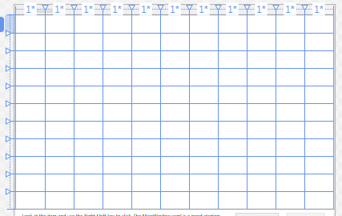
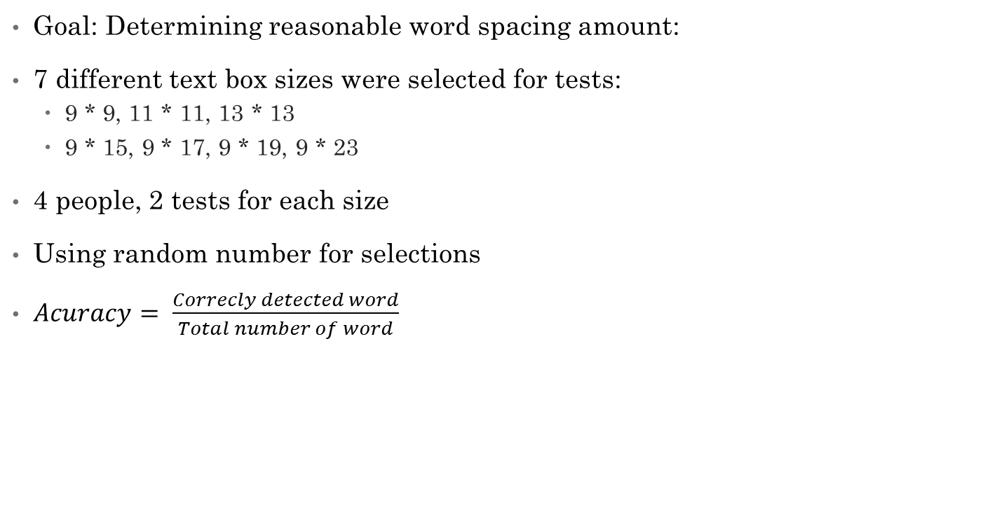
Experimentation for the Textbox Size
Goal: Determining reasonable word spacing amount:
7 different text box sizes were selected for tests:
9 * 9, 11 * 11, 13 * 13
9 * 15, 9 * 17, 9 * 19, 9 * 23
4 people, 2 tests for each size
Using random number for selections
$Acuracy= \frac{Correcly detected word}{Total number of word}$
11 * 11 grid line

Slide 5
Experimentation for the Textbox Size

Slide 6
Experimentation for the Textbox Size
The reasons of result variability
User learning process during the tests
High sensitivity of calibration process
limited number of experiments
People with individual differences:
Glasses
Contact lenses
Eye shapes

Slide 7
Experiment for the Delay Amounts
Goal: Determine reasonable delay
Delay governs when text is activated
Setup various amounts of manual delay:
Delay in milliseconds: 200, 300, 400, 500, 600
Participants rate user experience on Likert Scale of 1 to 5
Require participants to provide feedback explaining choice
Choose average amount as acceptable delay

Slide 8
Experiment for the Delay Amounts

Slide 9
Experiment for the Delay Amounts

